Slide 1
Valleys of Marsa Matrouh 25-26 June 2010 Prof. Salah A. Soliman University and Library of Alexandria

Slide 2
Habes Valley Thursday 24 June 2010

Slide 3
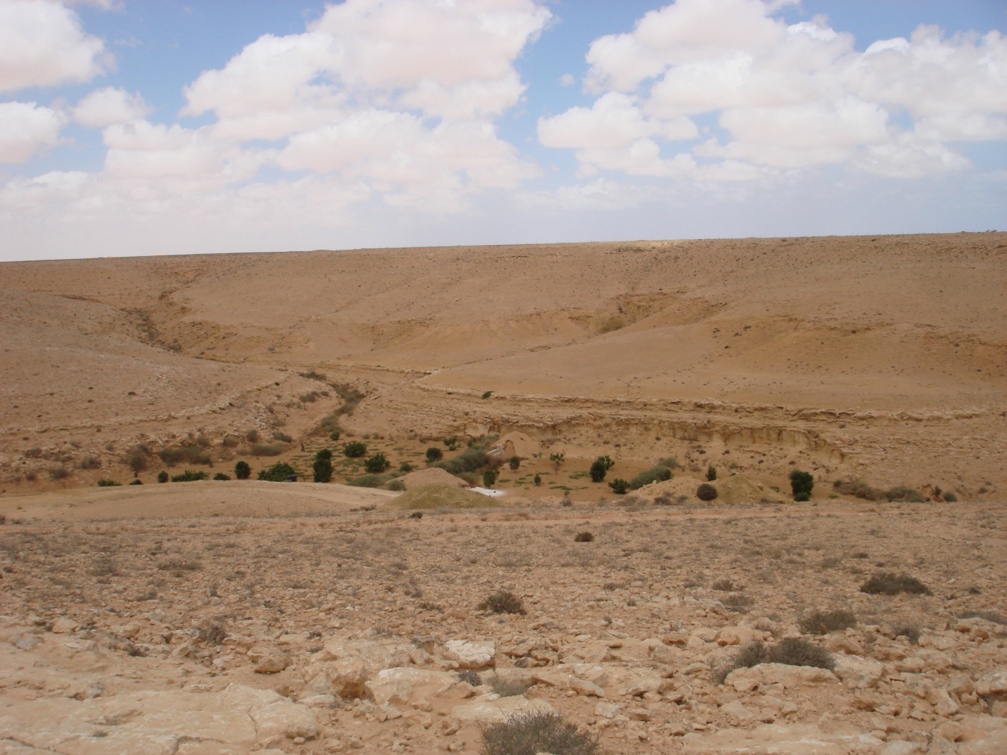
A caption of the valley

Slide 4
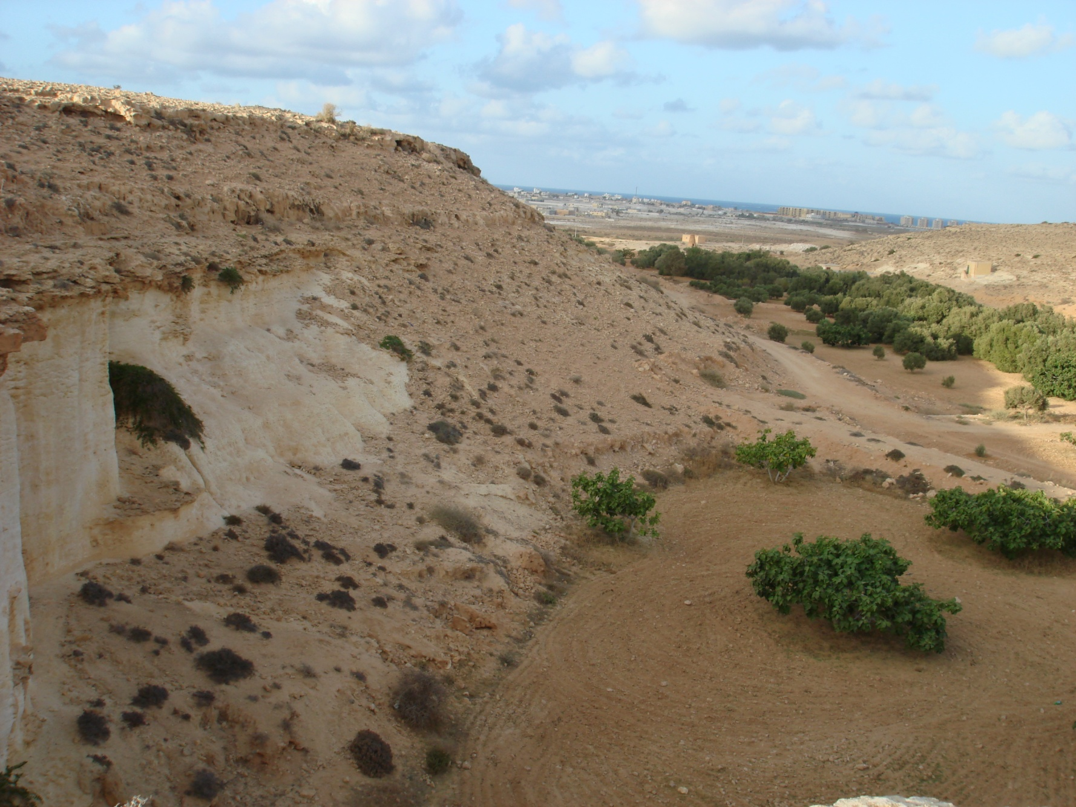

Slide 5
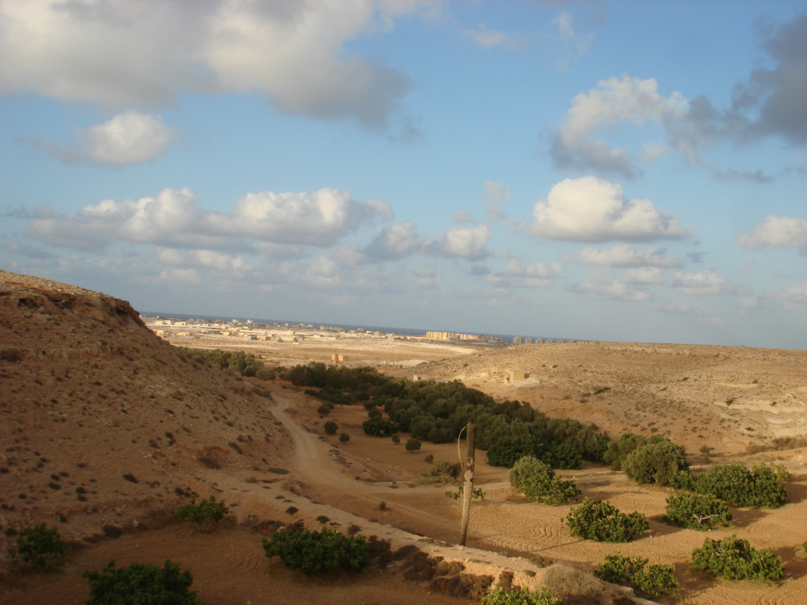

Slide 6
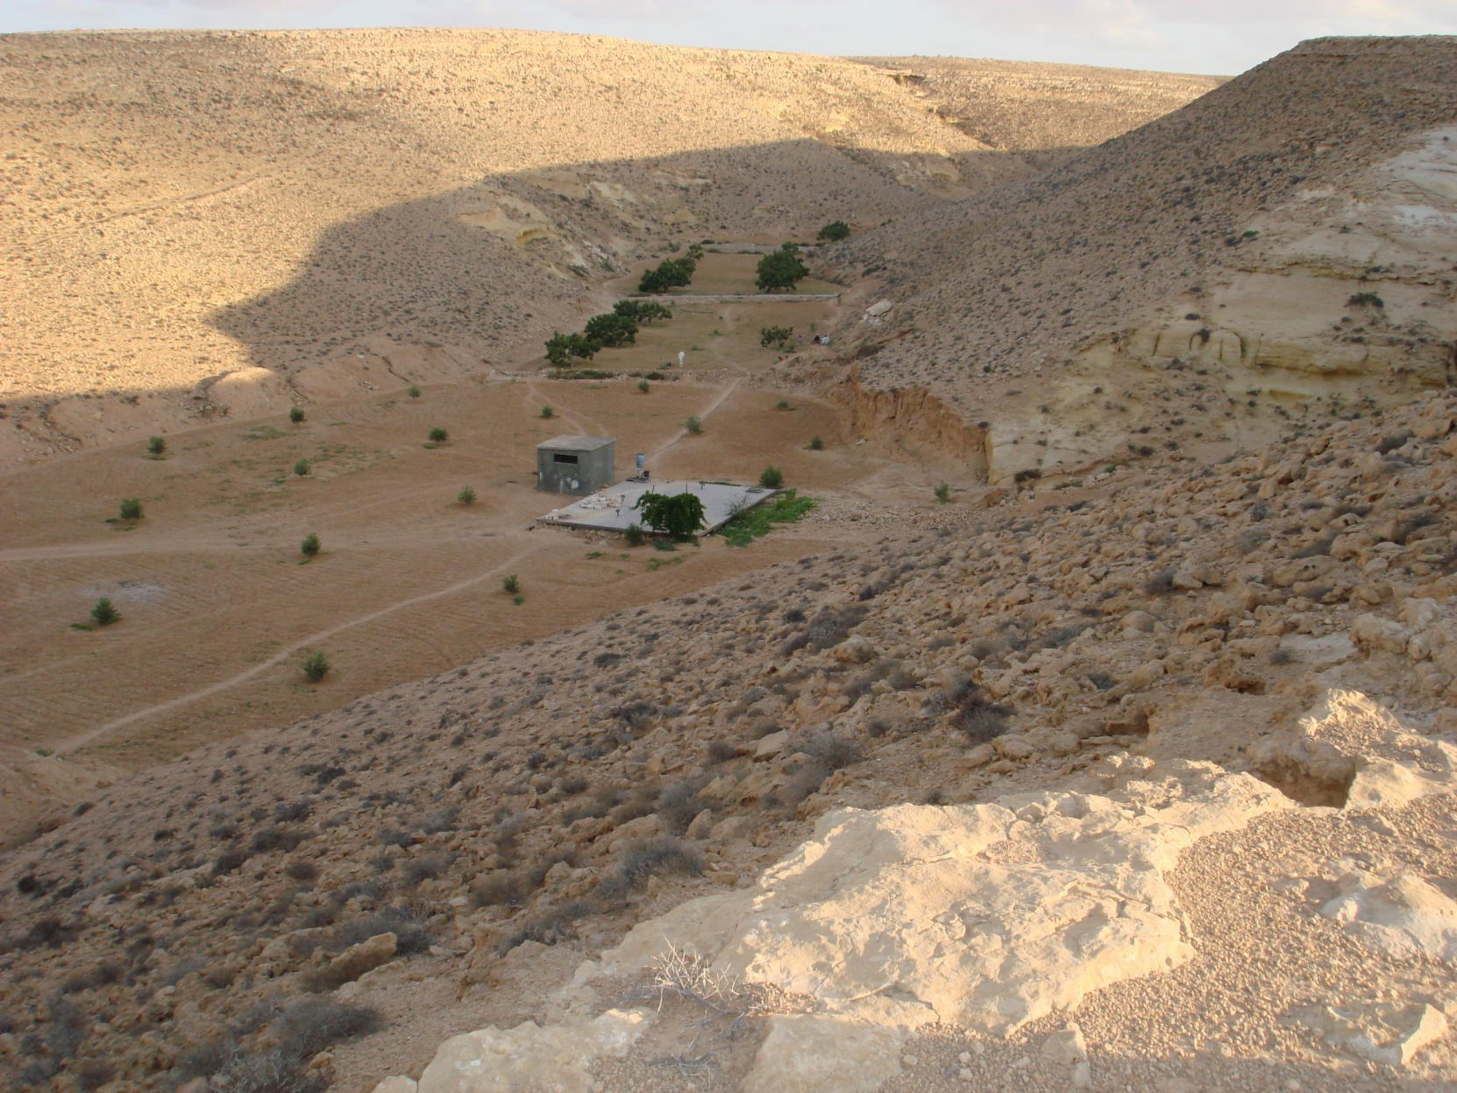
Precious water stored in a tank

Slide 7
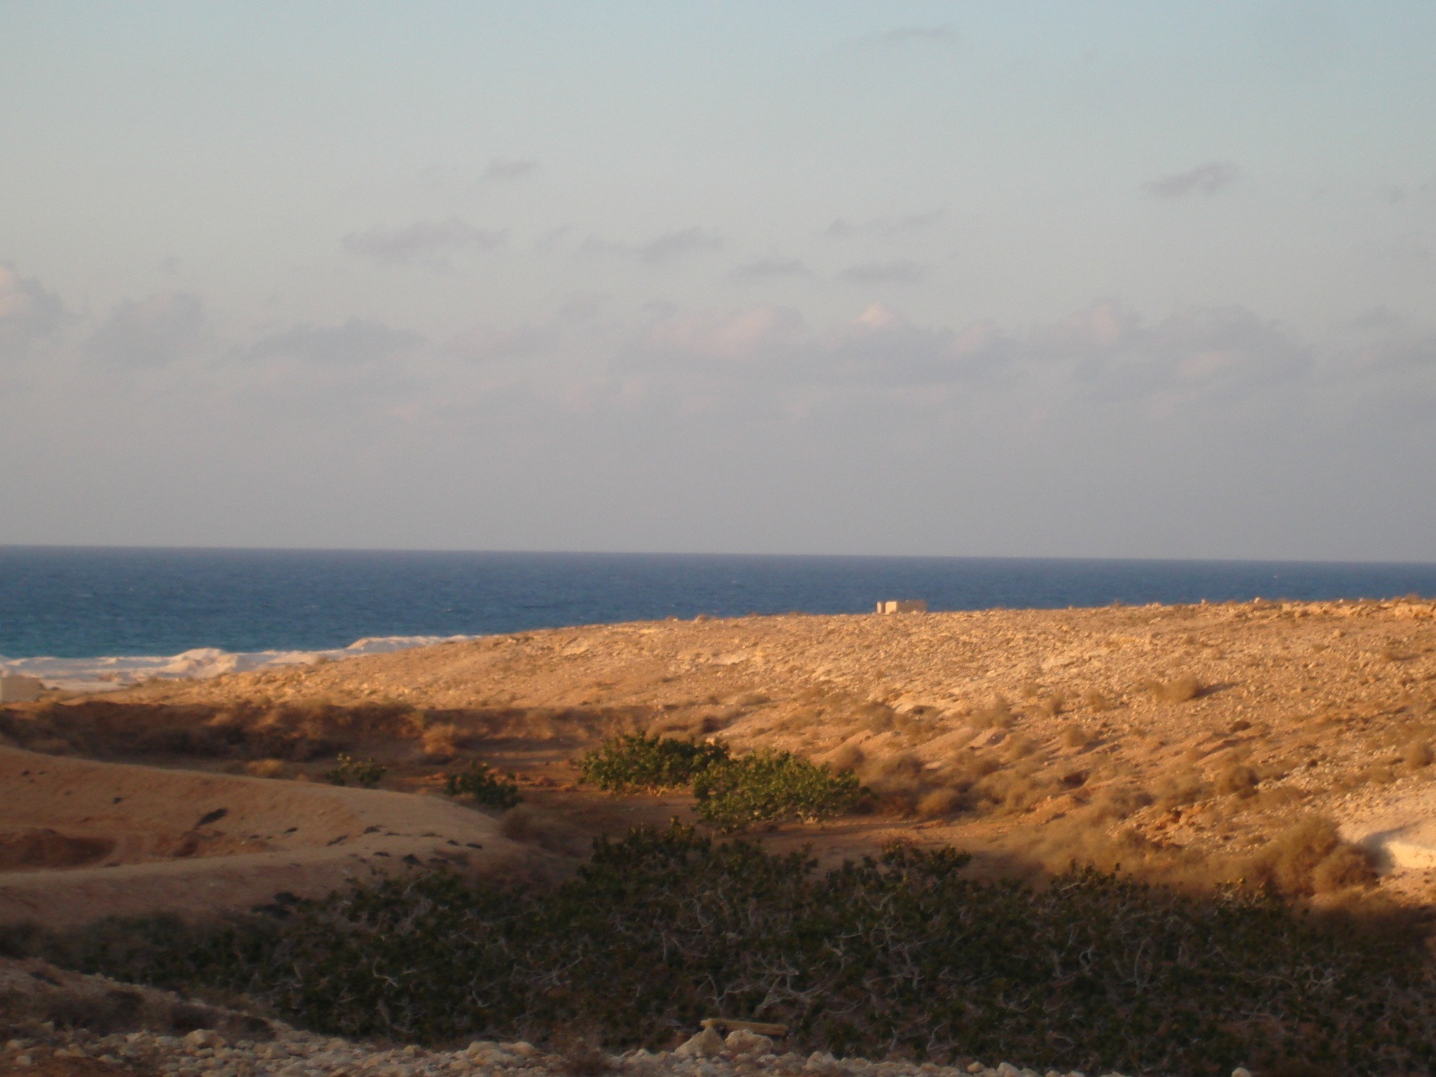
Valley heads to the Mediterranean sea

Slide 8
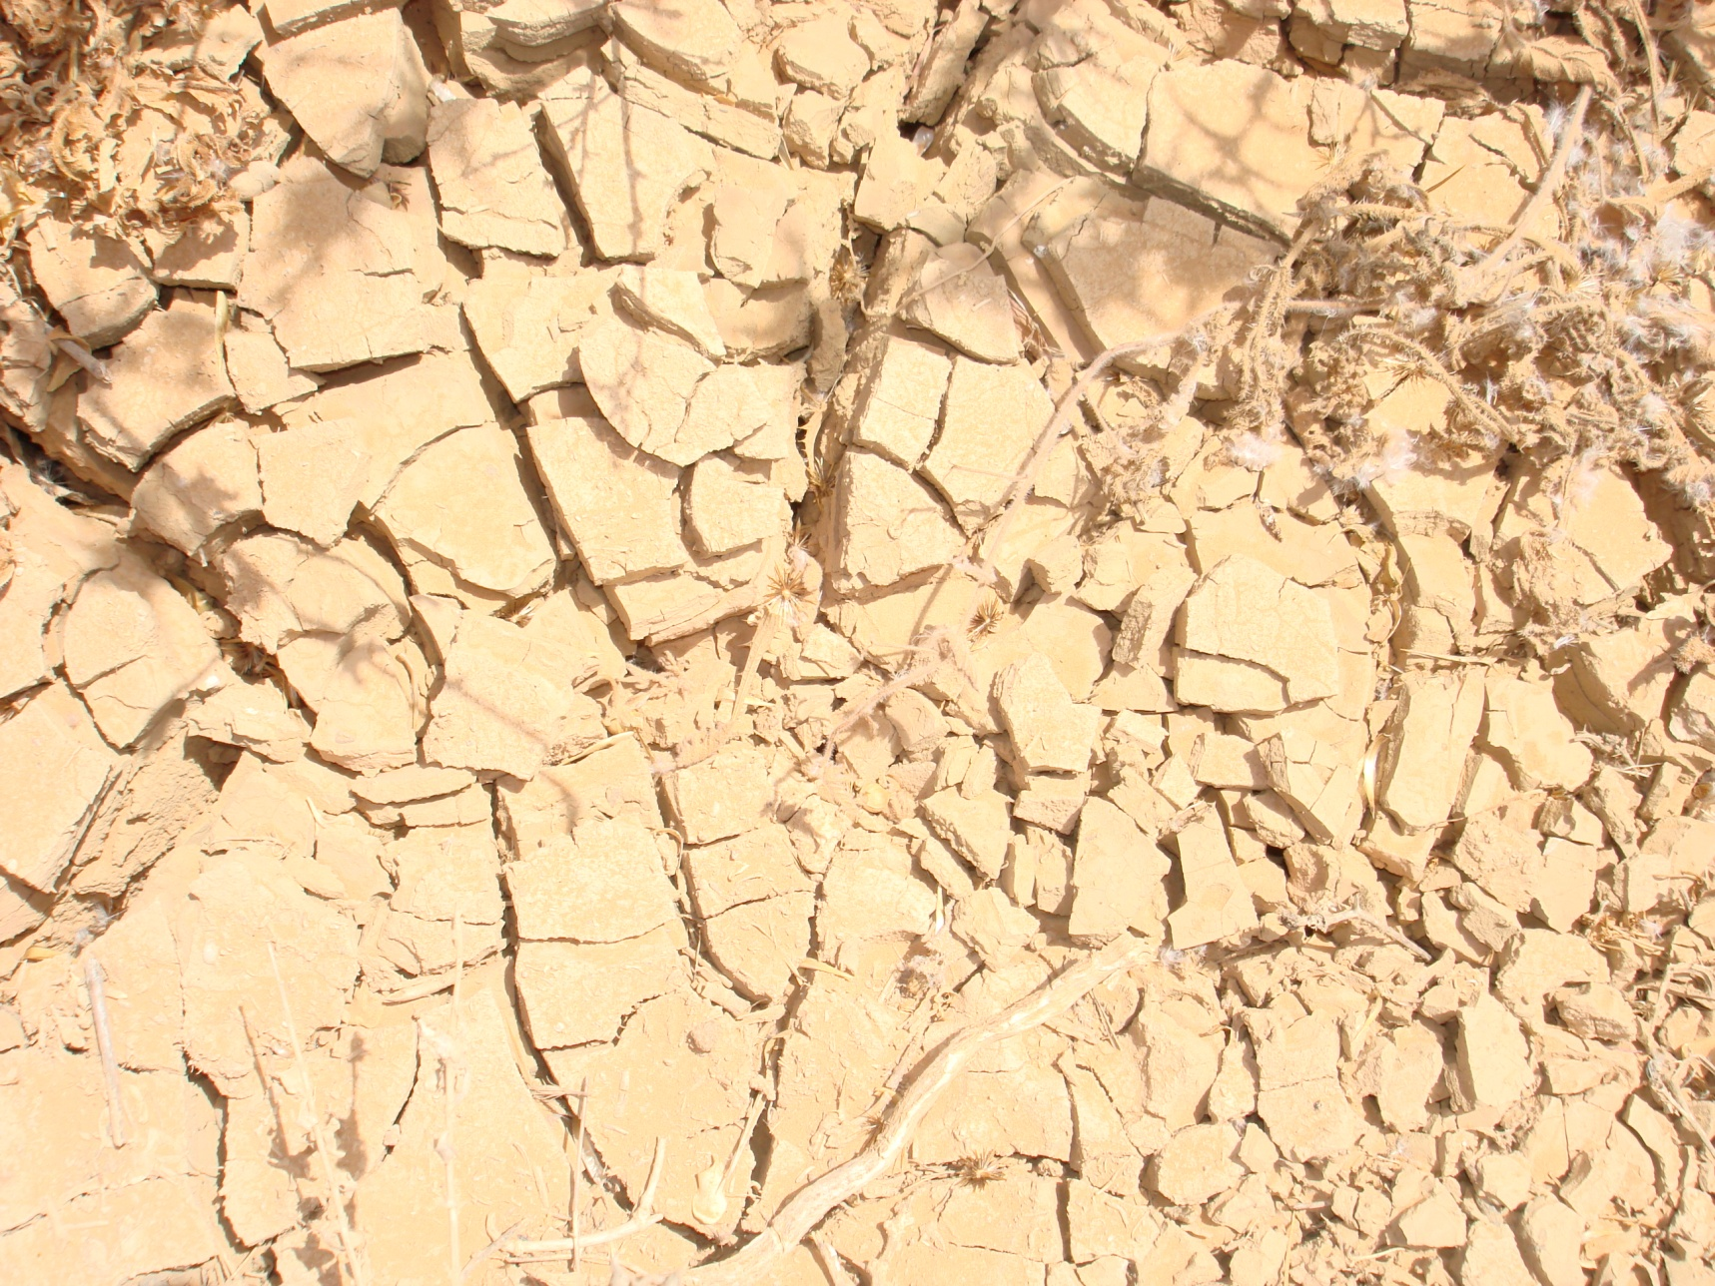
Need for Water

Slide 9
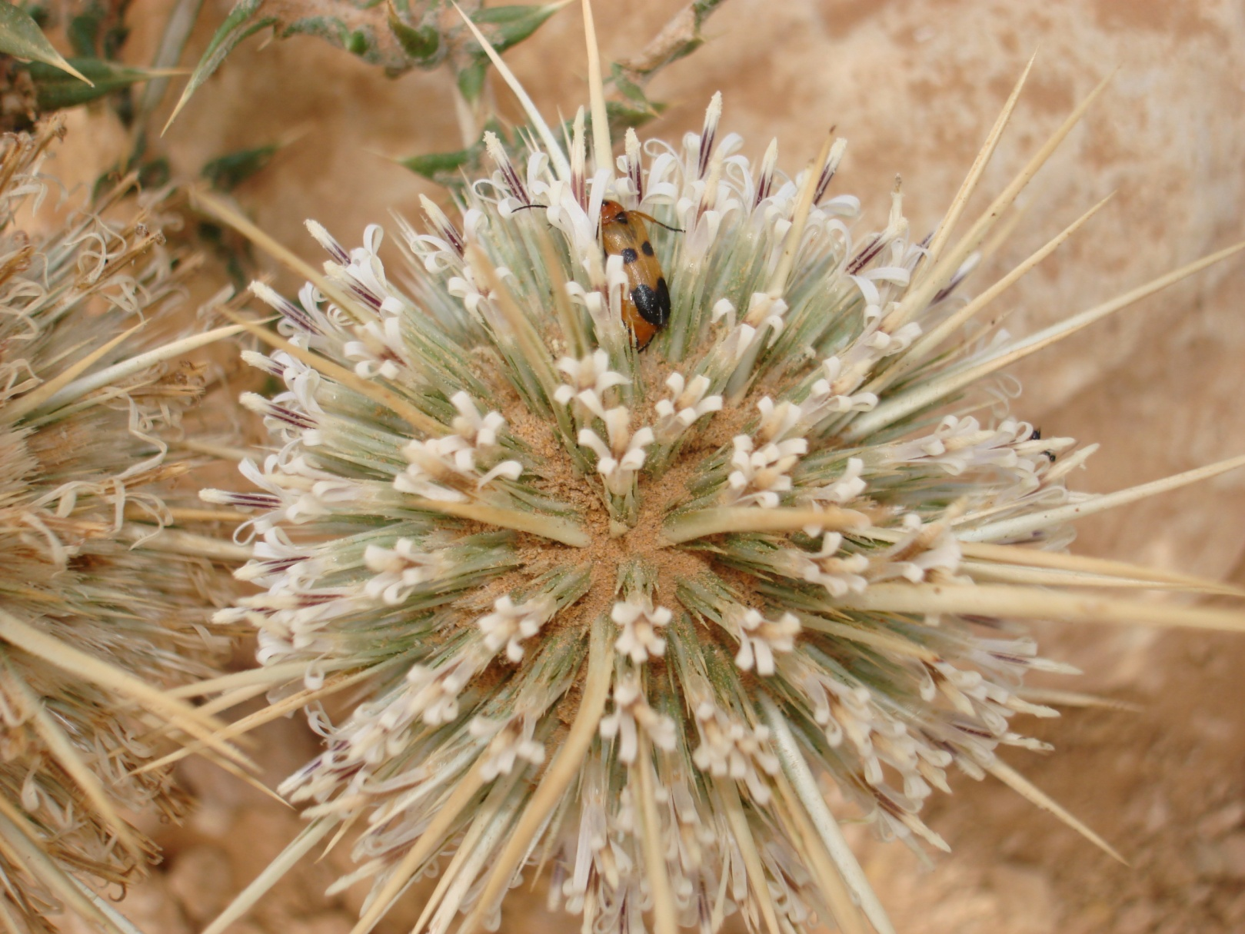
A caption of the habitat in the valley

Slide 10
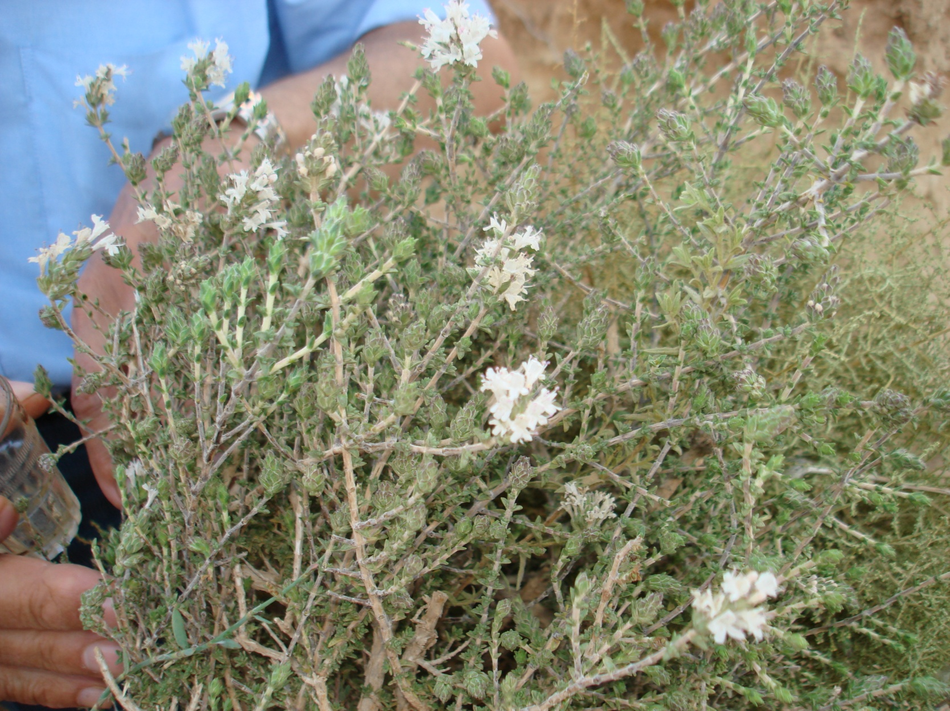
Wild thyme collected from the valley

Slide 11
Halk El-Dabae Valley (Hyene Mouth Vally) Friday 25 June 2010

Slide 12
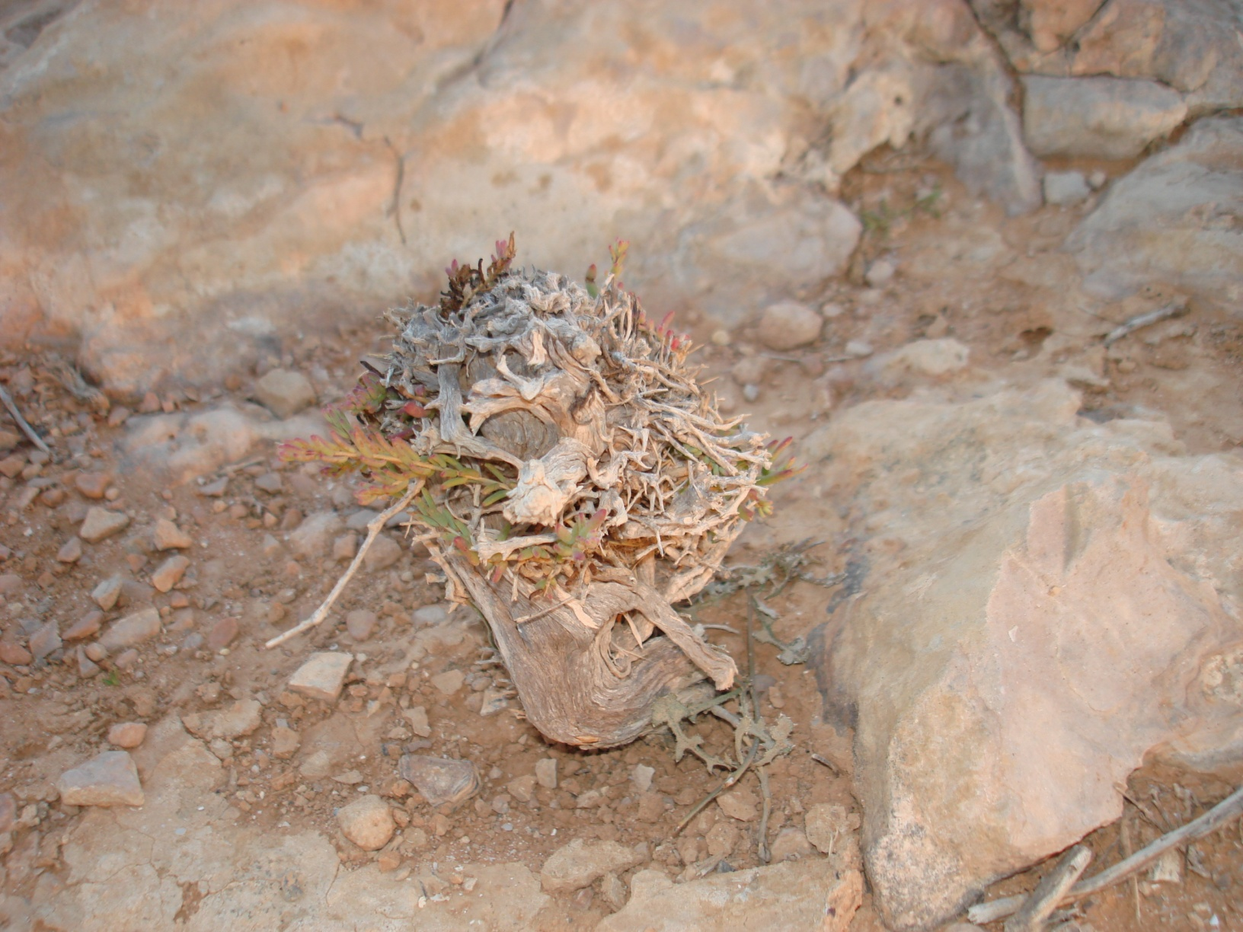
Just waiting for water

Slide 13
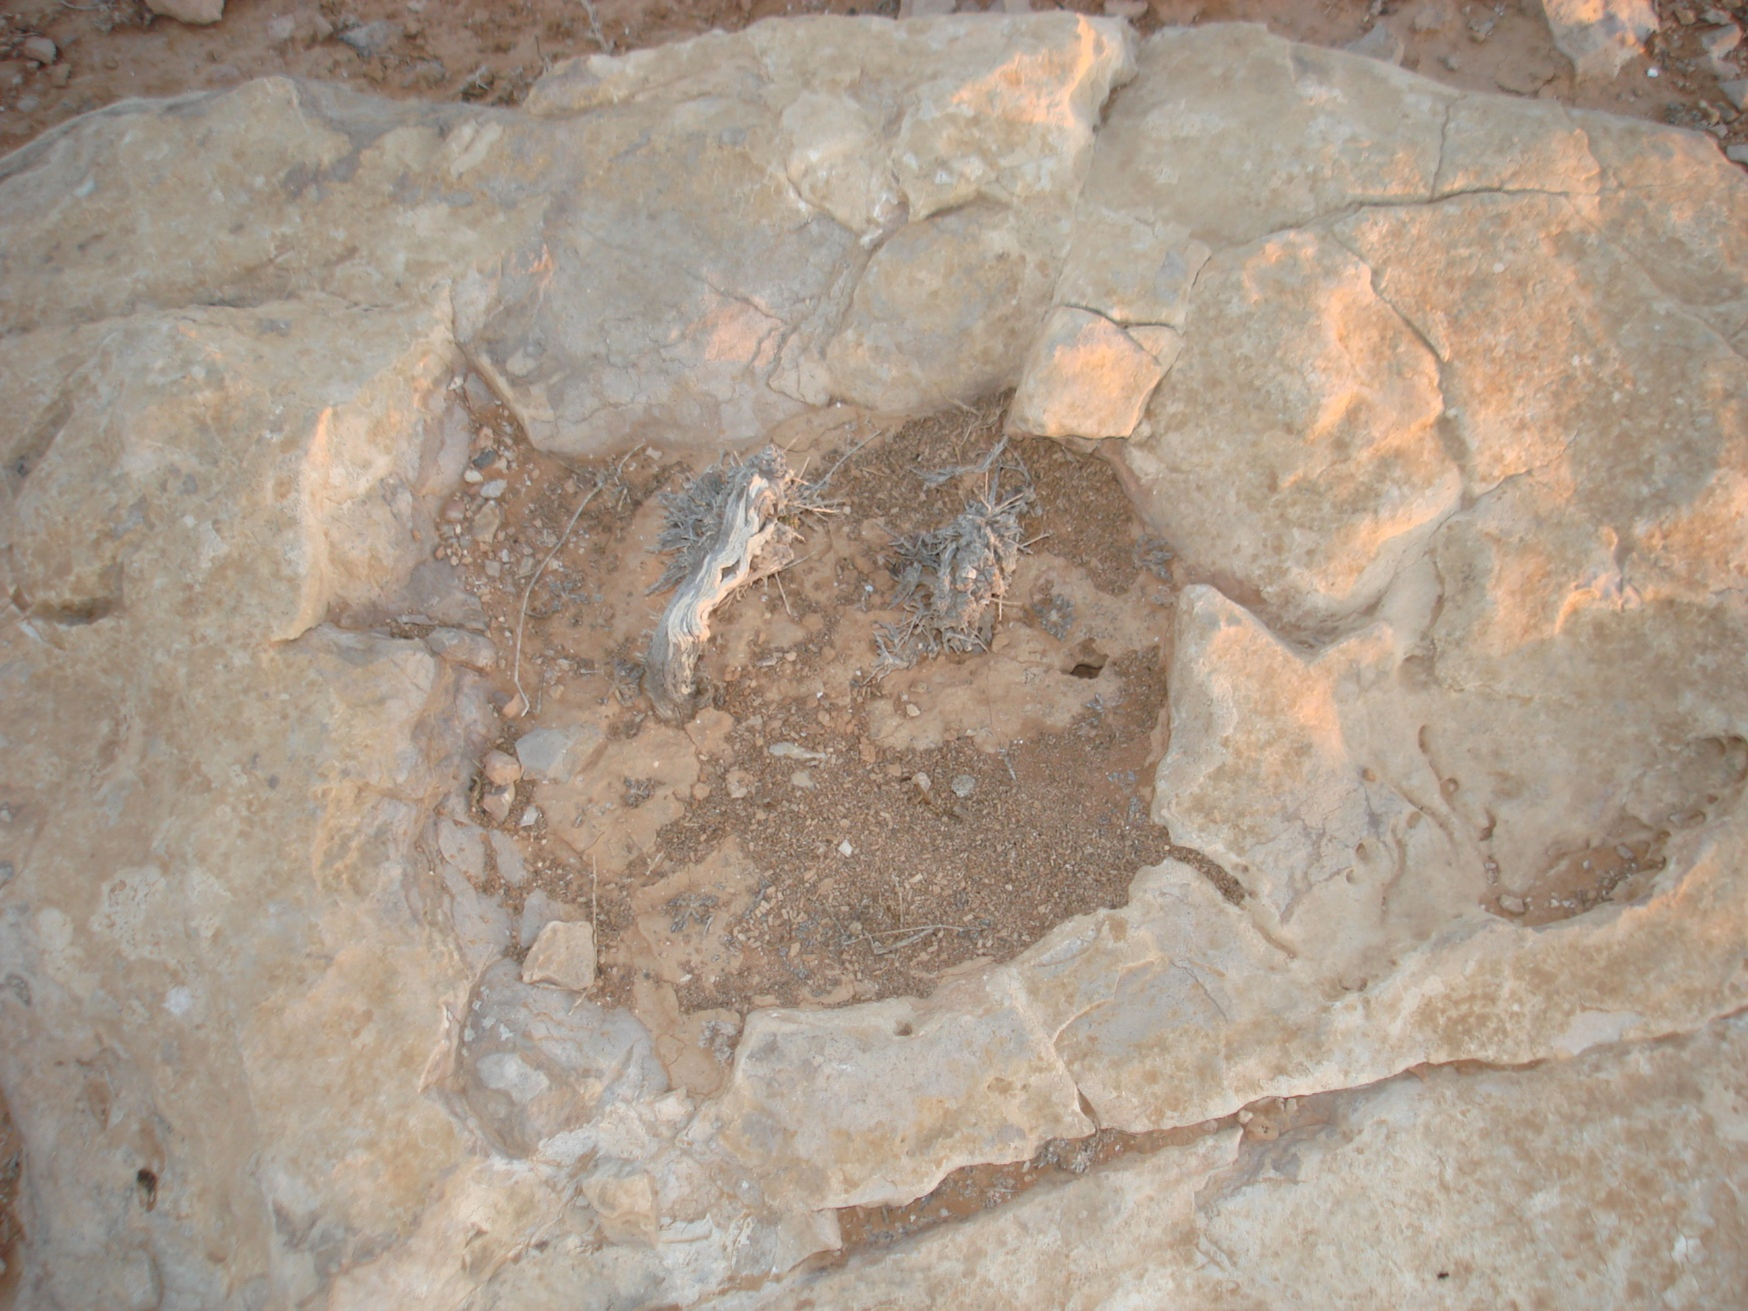
We are waiting for water

Slide 14
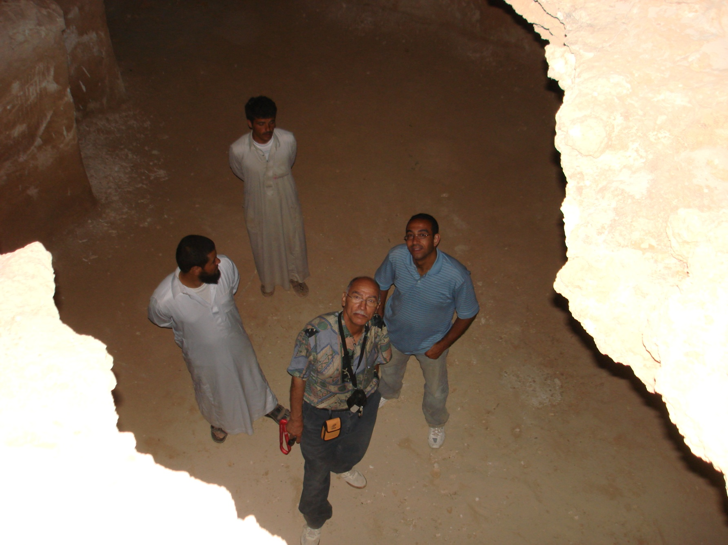
Inside a Roman constructed water storage cave

Slide 15
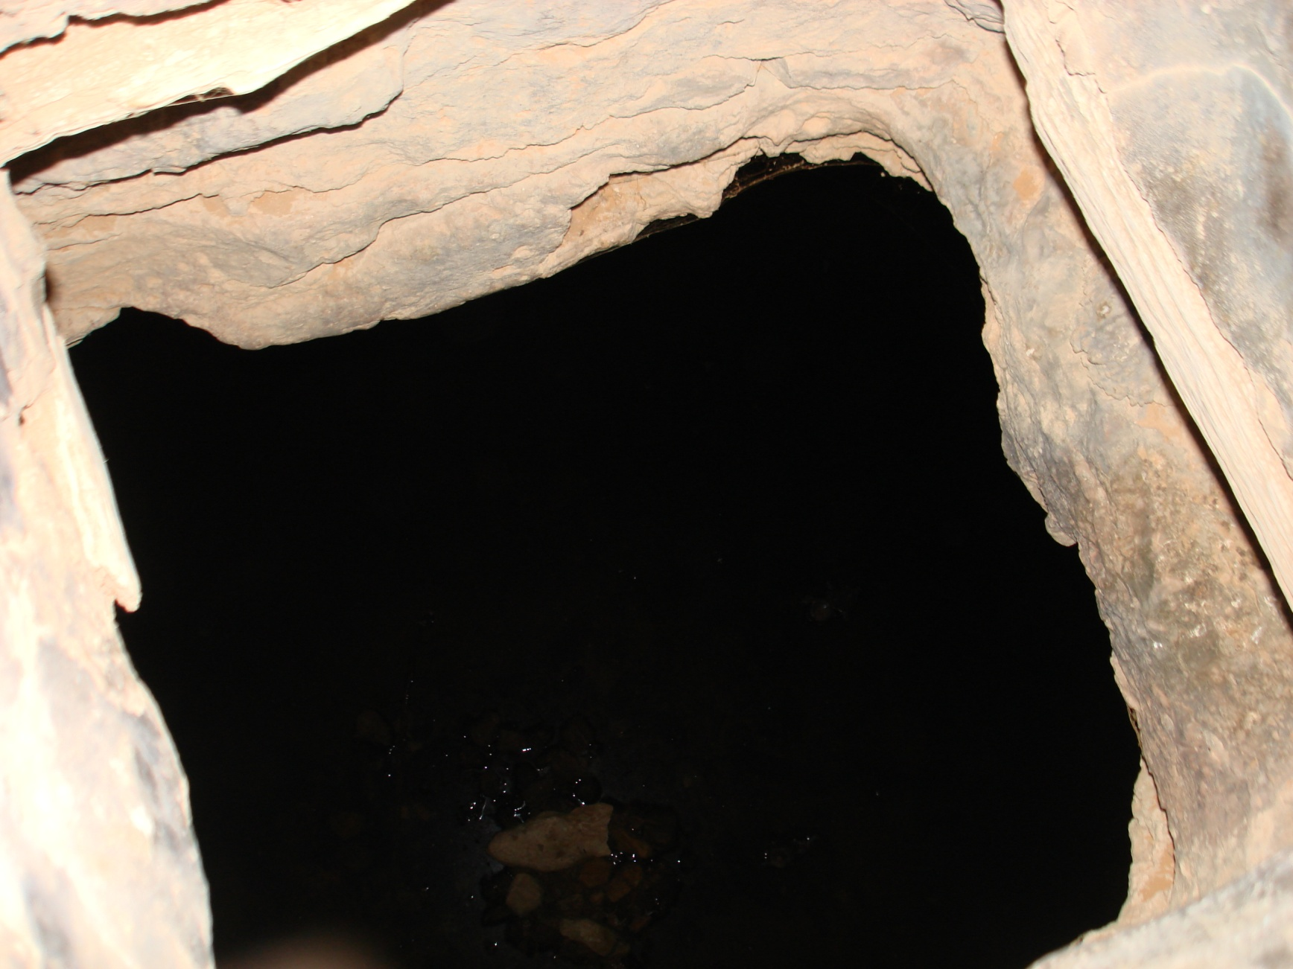
A Roman water storage cave

Slide 16
Digging for precious water

Slide 17
Thank You

